Slide 1
02
ACCOUNTS
DEPARTMENT
Contribution Boxes
Safe
Cleaning
Checklist
OPERATING MANUAL | NOVEMBER 2025
assembly hall | auckland

Slide 2
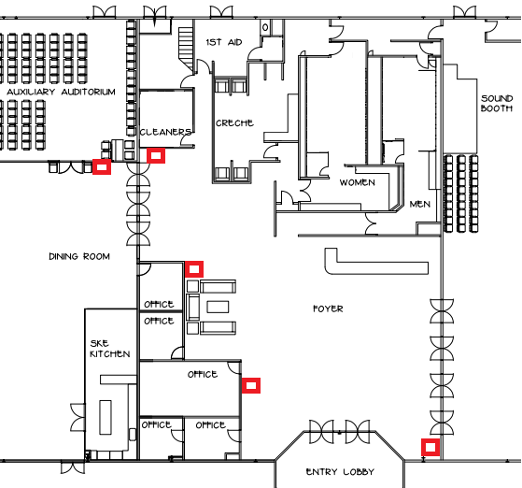
02 ACCOUNTS DEPARTMENT
Contribution Boxes
Safe
Cleaning
Checklist
CONTRIBUTION BOXES
Contribution boxes are located at the positions marked in red on the diagram below, namely:
• Foyer x 4
• Dining Room x 1
Two sets of keys to the contribution boxes and the Audit Office will be provided to the Accounts Overseer by the Assembly Overseer/Convention Coordinator. All the contribution boxes must be cleared and lids left open at the close of each assembly/each day of the convention.
assembly hall | auckland

Slide 3
02 ACCOUNTS DEPARTMENT
Contribution Boxes
Safe
Cleaning
Checklist
SAFE
A steel safe is provided. Only the key should be used to lock and unlock the safe. The combination must not be changed. At the conclusion of the Assembly/Convention, all monies must be removed from the AH.
CLEANING
The Accounts department is responsible for the cleaning of the accounts room at the end of the assembly day/each day of the convention.
All cleaning equipment is stored in the cleaning room.
assembly hall | auckland

Slide 4
02
ACCOUNTS DEPARTMENT
Please complete the task lists below
ACCOUNTS ROOM & FIRE/ALARM PANEL OFFICE CLEANING
Tidy desk, wipe desks with Aquamix #7 spray and blue microfiber cloth
Sanitise light switches, door handles and remotes using Aquamix #7 and blue microfiber cloth
All items neatly stored away in drawers
Remove schedules/paperwork from notice board
Empty rubbish bins
Vacuum carpet floors
Spot vacuum chairs
FINAL CHECKLIST
Ensure that all contribution boxes have been cleared and left open
Ensure that all keys have been returned to Assembly Overseer/Convention Coordinator
Check that no monies have been left in the safe and left open
All money and paperwork removed and in the care of the accounts overseer
Accounts room has been cleaned
Lights turned off
TV turned off
Return this checklist to event oversight
assembly hall | auckland

